Slide 1


SPEECH EMOTION RECOGNITION

Slide 2
OUR TEAM
Elif Aybüke COŞKUN
201811018
Furkan DURAN
201811027
Abdullah ÖZDER
202011410
Şima
KAYISI
201811043
İhsan BARDAKCI
201717007
Assist. Prof. Dr. Ayşe Nurdan SARAN

Slide 3
CONTENT
1
PROBLEM
4
TECHNOLOGIES
What brought us here?
What were the technologies and diagrams used?
2
ANALYSIS
5
CONCLUSION
What we learned and designed as a result of our researches?
To sum up
3
6
DIFFERENCE
PROTOTYPE
What is our difference?
Prototype of the SER web-site

Slide 4




INTRODUCTION
CALL CENTER
VIRTUAL ASSISTANT
CUSTOMER SERVICES

Slide 5


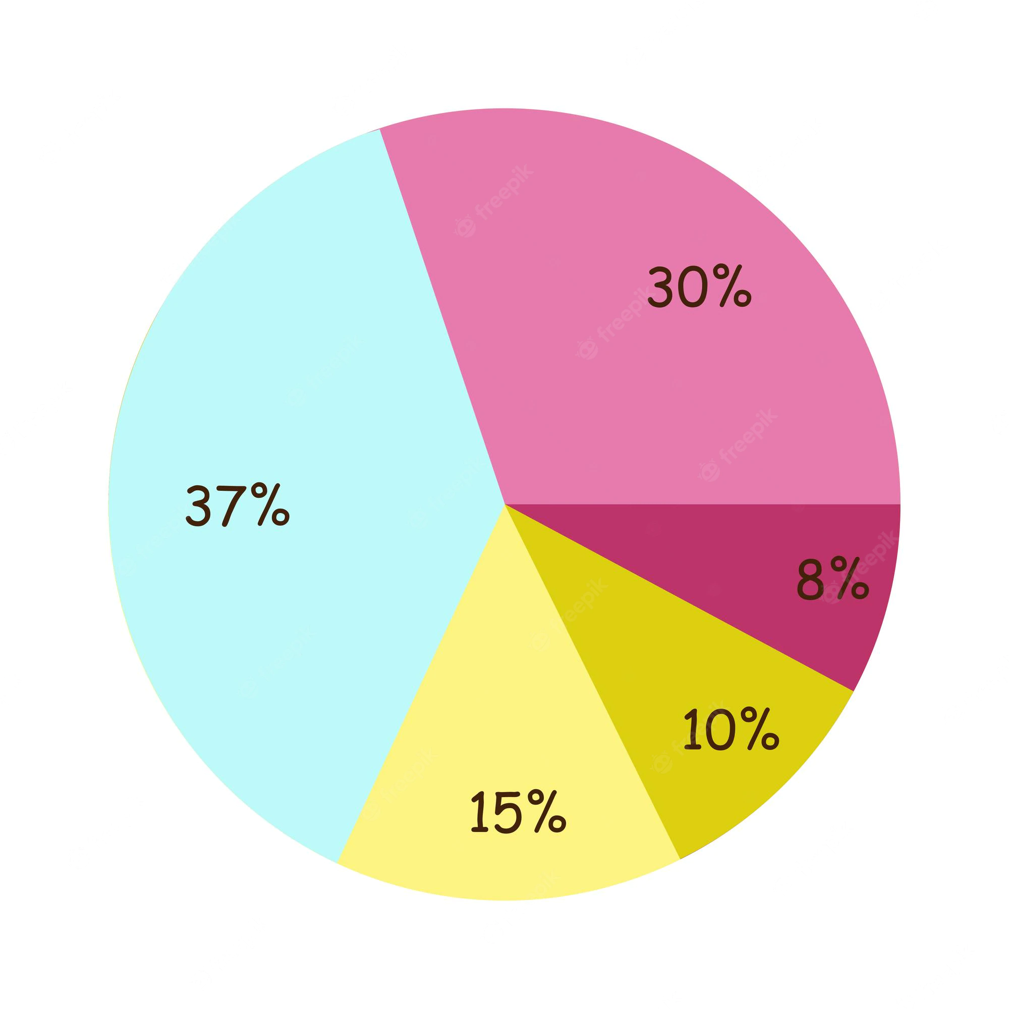
PROBLEM
What brought us here?
😄
😐
😢
😠
😑
Speech Analysis
Evaluate of Emotional Data
Analysis Result

Slide 6



ANALYSIS
What we learned and designed as a result of our researches?
Speech is the most important and effective main way of human interaction.
There is a transfer of emotion in every person's speech.
Analyzing speech signals.

Slide 7



SYSTEM PURPOSE
Upload File
Machines' understanding of human emotions

Slide 8
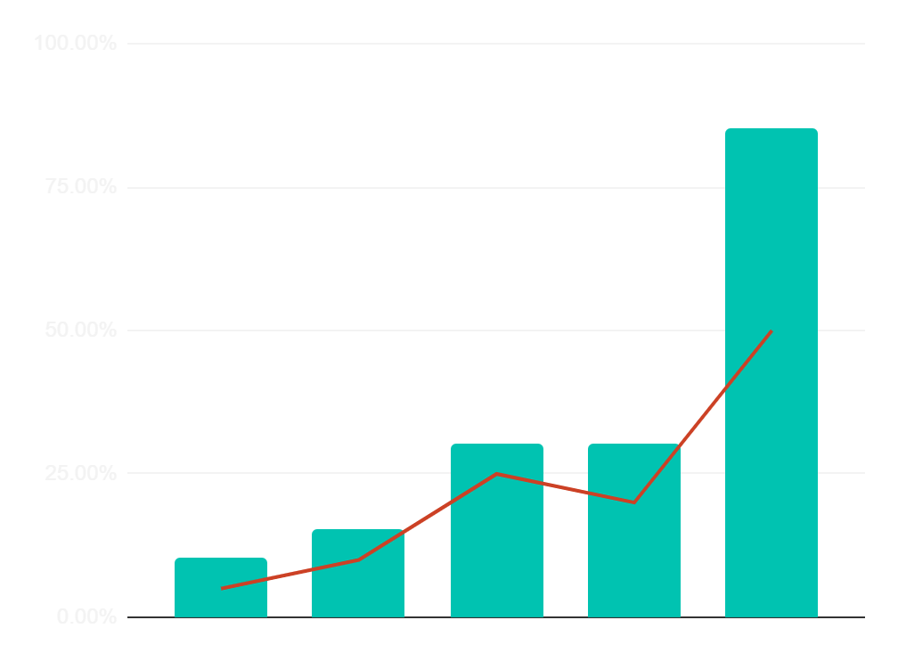


SYSTEM PURPOSE
The aim of this system is to analyze the emotional state of these people as a result of taking the texts that people have spoken or written.
NEUTRAL
😑
FEAR
😐
ANGRY
😠
SAD
😢
HAPPY
😄

Slide 9
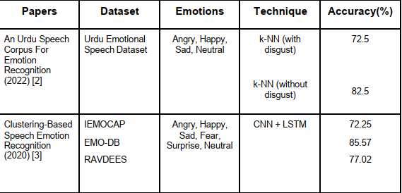
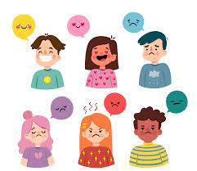
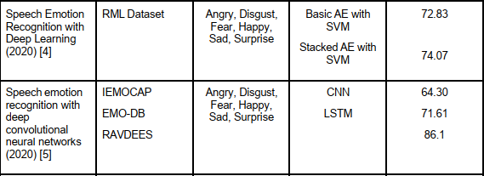
SIMILAR PROJECTS
When the projects done in the past are examined, it has been observed that Angry, Disgusted, Fear, Happy, Sad and Surprised emotions intensified.

Slide 10



DIFFERENCE
What is our difference?
WHAT SETS US APART
Emotion analysis from text and audio files.

Slide 11
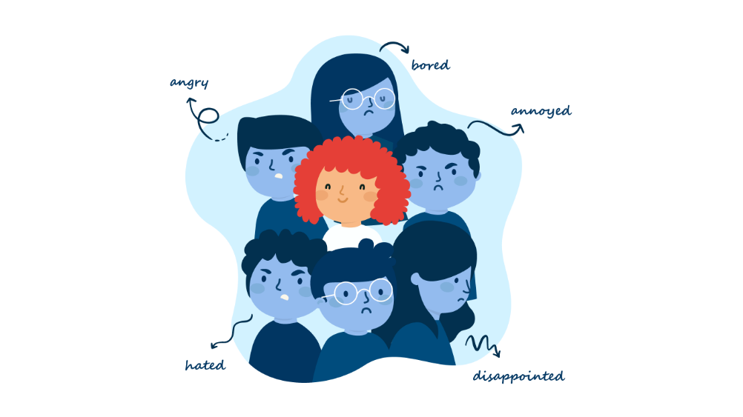
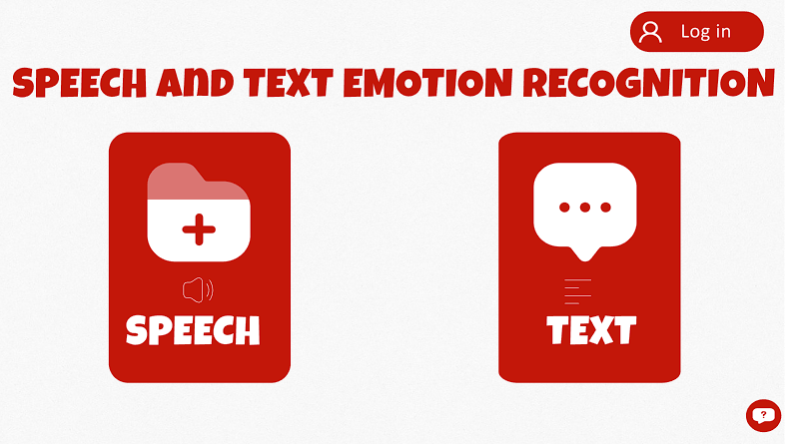
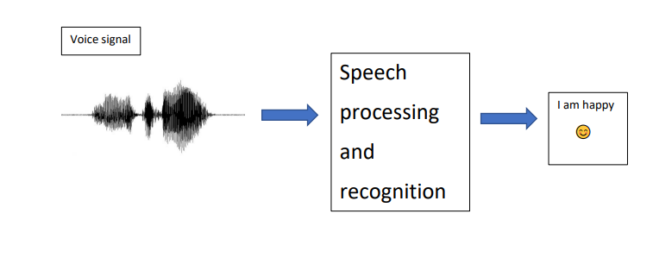
CONTRIBUTIONS
We work from both audio and text files.
After the audio file is processed, it is converted into text and the mood appears on the screen.

Slide 12




ADVANTAGES
1
1-EASE OF USE
4
2
2- FEWER ERRORS
3
4- SAVING ON TIME
3-NO REQUIREMENT OTHER THAN PC

Slide 13
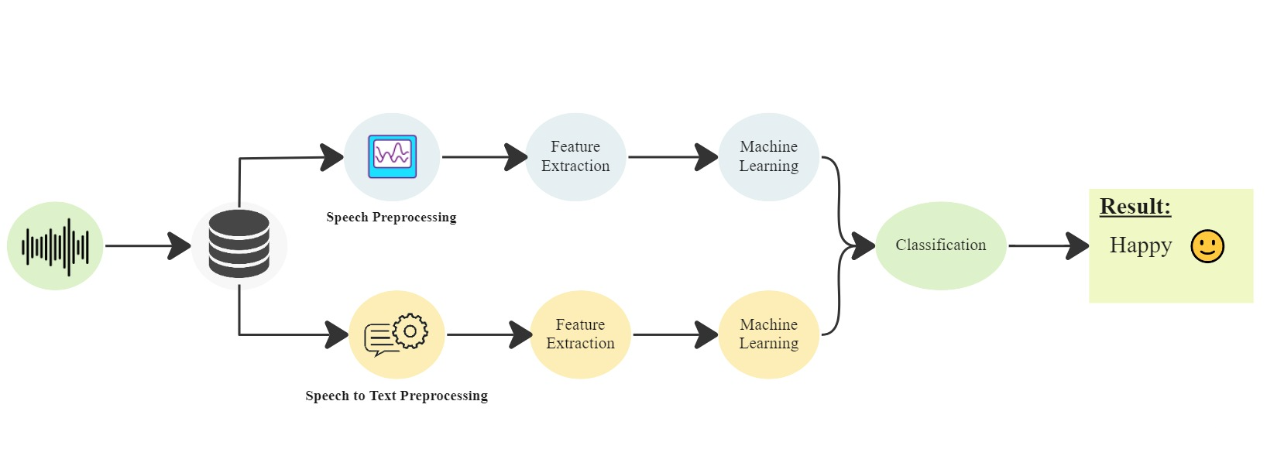
FLOWCHART

Slide 14


FEATURE EXTRACTIONS
The speech features can be divided into 4 main categories:
- Continuous Speech Features
- Voice Quality Features
- Spectral-Based Speech Features
- Nonlinear TEO-Based Features

Slide 15
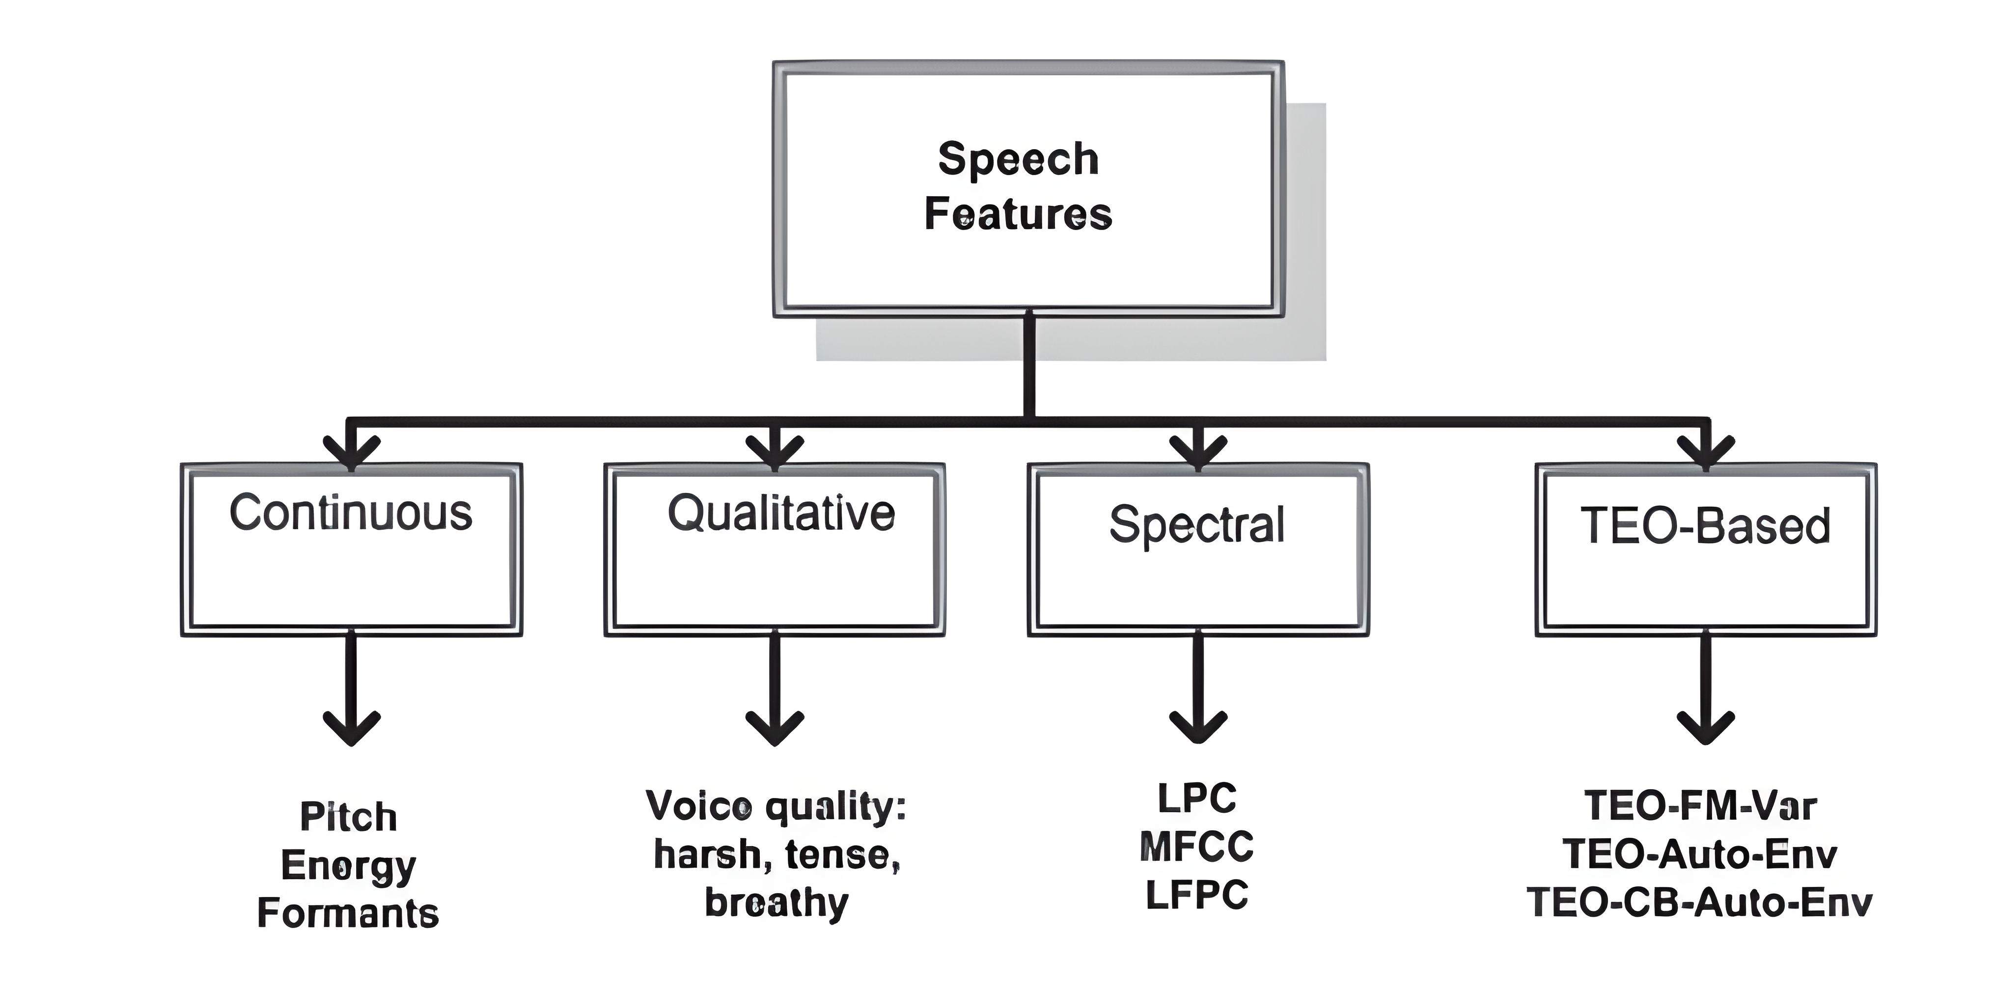
FEATURE EXTRACTIONS

Slide 16
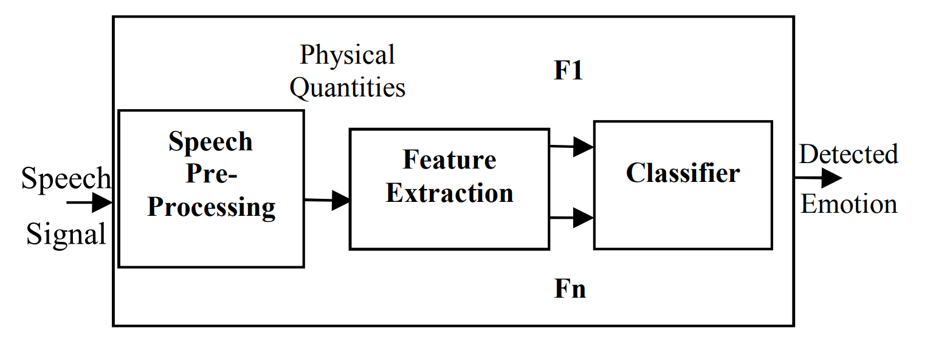
FEATURE EXTRACTIONS

Slide 17
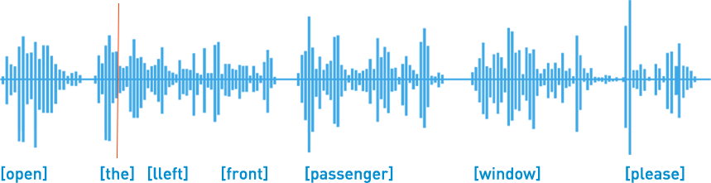
FEATURE EXTRACTIONS
Continuous Speech Features:
- Pitch-Related Features
- Formants Features
- Energy-Related Features
- Timing Features

Slide 18
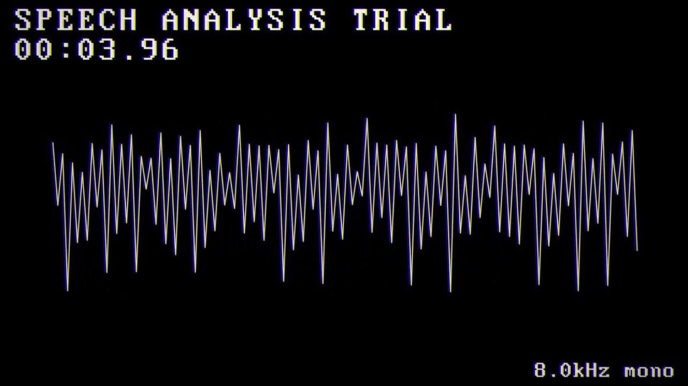
FEATURE EXTRACTIONS
Voice Quality Features:
- Voice Level
- Voice Pitch
- Phrase, Phoneme, Word and Feature Boundaries
- Temporal Structures

Slide 19
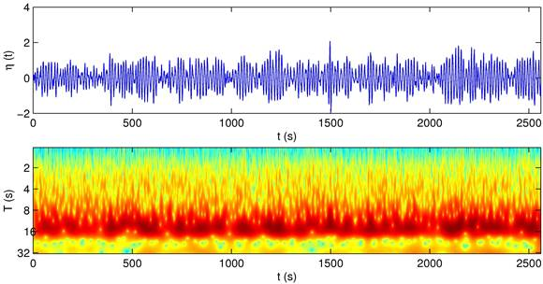
FEATURE EXTRACTIONS
Spectral-Based Speech Features:
- Linear Predictor Coefficient (LPC)
- Mel Frequency Cepstral Coefficient (MFCC)
- Log Frequency Power Coefficient (LFPC)

Slide 20
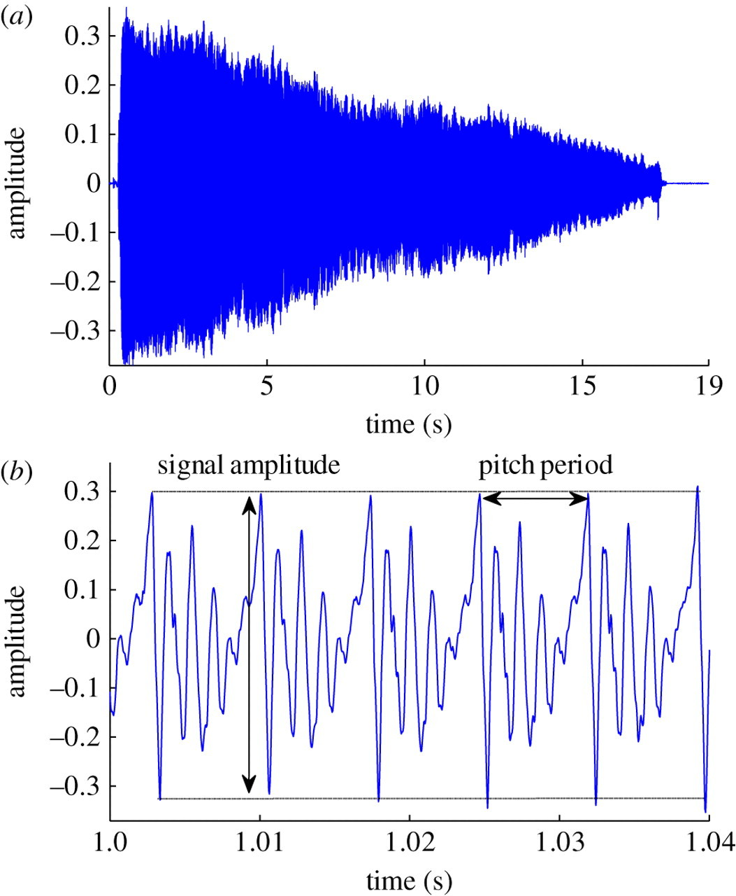
FEATURE EXTRACTIONS
Nonlinear TEO-Based Features
- TEO Decomposed FM Variation
- Normalized TEO Autocorrelation Envelope Area
- Critical Bandbased TEO Autocorrelation Envelope Area

Slide 21







TECHNOLOGIES
What were the technologies and diagrams used?

Slide 22



FUTURE WORKS
01
CALL CENTER
02
03
FACIAL EXPRESSION
HEART RATE

Slide 23
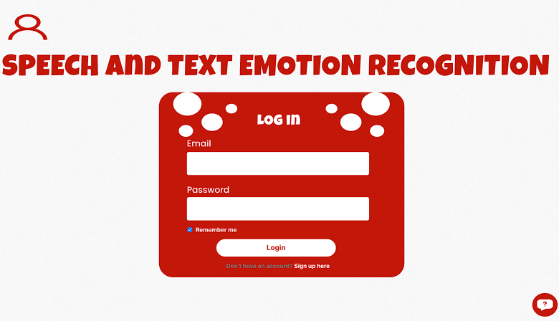
PROTOTYPE
Prototype of the SER web-site
HOME PAGE
LOGIN PAGE

Slide 24
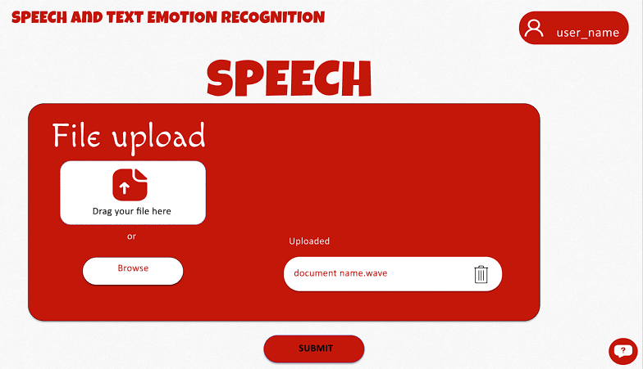
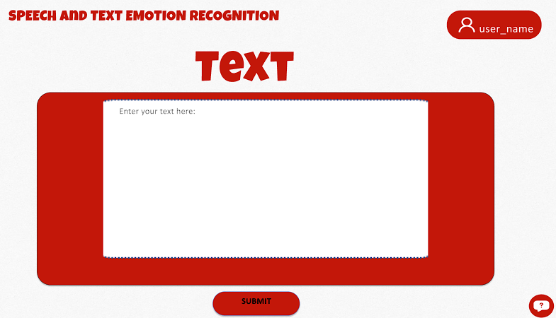
PROTOTYPE
Prototype of the SER web-site
UPLOAD SPEECH FILE PAGE
UPLOAD TEXT PAGE

Slide 25
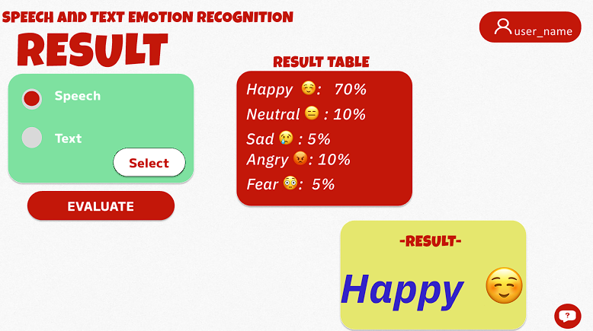
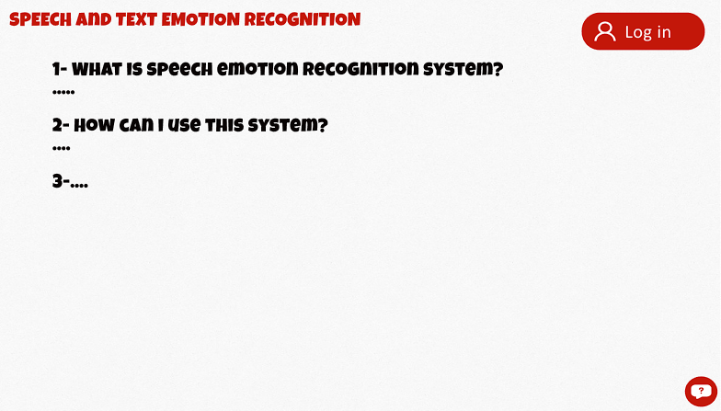
PROTOTYPE
Prototype of the SER web-site
RESULT PAGE
FAQ PAGE

Slide 26


CONCLUSION
To sum up

Slide 27
THANK YOU FOR LISTENING!!

